Slide 1
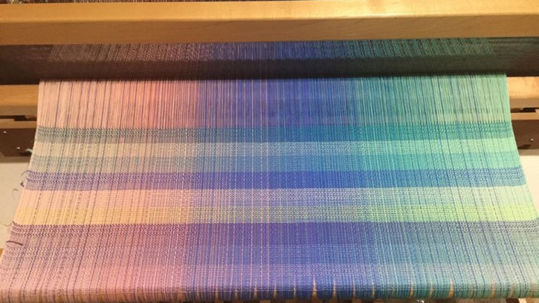
GPU Acceleration with the C++ Standard Library
Notes:
Welcome to GPU Acceleration with the C++ Standard Library.
My name is Josh Wyatt, and I am a curriculum developer at the NVIDIA Deep Learning Institute. I’m happy to be working with you today.
Harnessing the incredible acceleration of NVIDIA GPUs is easier than ever. For over a decade NVIDIA has been collaborating in the C++ standard language committees on the adoption of features to enable parallel programming without the need for additional extensions or APIs. On account of this work, developers can now write GPU-accelerated C++ code using only standard language features: no language extensions, pragmas, directives, or non-standard libraries.
Standard language parallelism is the simplest, most productive, and most portable approach to accelerated computing. It requires nothing more than ISO standard C++ and allows developers to write applications that are parallel-first such that there is never a need to port them to new platforms in order to run them on GPU-accelerators.
In this interactive hands-on workshop, we introduce how to write GPU-accelerated applications using only C++ standard language features. By the time you complete this workshop you will be able to:
Rewrite serial code to instead use C++ standard template library parallel algorithms
Use ISO C++ execution policies to indicate when algorithms may be run in parallel on platforms supporting parallelism
Use the NVIDIA HPC C++ compiler (NVC++) to compile standard C++ algorithms for execution on NVIDIA GPUs
Write C++ applications that are parallel by default so they can run without modification on GPU-accelerated (and many other) platforms

Slide 2
Intended Audience
Audience: students, developers, researchers and practitioners interested in developing portable HPC applications using ISO C++
Prerequisites: experience with C++11 (lambdas, STL algorithms)

Slide 3
GPU Acceleration with the C++ Standard Library
C++ Prerequisites
Fundamentals of ISO C++ Parallelism
Indexing, Ranges & Views
Interactive Materials

Slide 4
C++ Prerequisites
Notes:
We are going to be covering the C++ prerequisites first, which is basically standard library algorithms, and the associated use of lambdas. Many of you will already have a great deal of experience using these aspects of C++, in which case a lot of what we cover in this section will be review. Many of you, however, may not have a lot of experience working with these aspects of C++. They are not difficult to learn, but ultimately, your ability to work fluently with the standard library algorithms, which often require the use of lambdas, will determine how successful you will be in writing C++ code that is “parallel first,” which is to say, can be compiled and run on environments with either multiple CPUs or one or more GPUs, without any modification.

Slide 5
ISO C++ lambdas
Lambdas simplify the creation of function objects. This...
std::vector<double> v = {1, 2, 3, 4};
double s = 2.;
auto f = [s,&v](int idx) { return v[idx] * s; };
assert(f(1) == 4);
Notes:
C++11 introduced lambdas, and on this slide, we will demonstrate the use of a very simple lambda.
First we define a vector, v, and initialize it with 4 values. Next, we define a scalar value, s.
On the next line we define a lambda, f. Lambdas allow us to define functions in place. Lambda functions can store some information from its environment. In the body of the function, we can access the vector, where we access a value at a passed-in index which we then multiply by the scalar s, and then return. Once we have constructed the lambda we can, as you see on the last line, call the lambda function.
So, lambdas simplify the creation of function objects. Typically, one would have to do this by the creation of a struct.

Slide 6
ISO C++ lambdas
Lambdas simplify the creation of function objects. This...
...is equivalent to...
std::vector<double> v = {1, 2, 3, 4};
double s = 2.;
auto f = [s,&v](int idx) { return v[idx] * s; };
assert(f(1) == 4);
struct __unnamed {
double s;
std::vector<double>& v;
double operator()(int idx) {
return v[idx] * s;
}
};
__unnamed f{s, v};
assert(f(1) == 4);
Notes:
A function object is just an object, like a struct or class, with an operator defined such that it can be called like a function. We can imagine the lambda defined here as being expanded by the compiler to be the displayed struct, which has the operator defined such that we can call it.
Lambda functions are anonymous, or unnamed.

Slide 7
ISO C++ lambdas
The […] is called the "lambda capture" and controls how variables are stored within the lambda object:
std::vector<double> v = {1, 2, 3, 4};
double s = 2.;
auto f = [s,&v](int idx) { return v[idx] * s; };
assert(f(1) == 4);
struct __unnamed {
double s;
std::vector<double>& v;
double operator()(int idx) {
return v[idx] * s;
}
};
__unnamed f{s, v};
assert(f(1) == 4);
Notes:
The square brackets of the lambda are called the lambda capture, and they control how values in the lambda from the environment, such as v and s, are stored in this object.

Slide 8
ISO C++ lambdas
The […] is called the "lambda capture" and controls how variables are stored within the lambda object:
[s] captures s "by value" (makes a copy)
std::vector<double> v = {1, 2, 3, 4};
double s = 2.;
auto f = [s,&v](int idx) { return v[idx] * s; };
assert(f(1) == 4);
struct __unnamed {
double s;
std::vector<double>& v;
double operator()(int idx) {
return v[idx] * s;
}
};
__unnamed f{s, v};
assert(f(1) == 4);
Notes:
So for example, when we supply a value by its name, like we do here in this lambda capture with s, then it will be passed by value, which means a copy of it will be created in the function object.

Slide 9
ISO C++ lambdas
The […] is called the "lambda capture" and controls how variables are stored within the lambda object:
[s] captures s "by value" (makes a copy)
[&v] captures v "by reference" (stores a pointer)
std::vector<double> v = {1, 2, 3, 4};
double s = 2.;
auto f = [s,&v](int idx) { return v[idx] * s; };
assert(f(1) == 4);
struct __unnamed {
double s;
std::vector<double>& v;
double operator()(int idx) {
return v[idx] * s;
}
};
__unnamed f{s, v};
assert(f(1) == 4);
Notes:
With an ampersand, we can tell the compiler that we want to capture a value by reference.
So here we have an ampersand v, such that instead of copying all the elements of v into the function object, we only want a pointer that points the values of the vector.

Slide 10
ISO C++ lambdas
Lambda captures support "capture defaults" that capture all variables used within the lambda:
[&,s] captures s "by value" (makes a copy) and all other used variables "by reference" (store pointers)
[=,&v] captures v "by reference" (stores a pointer to v) and all other used variables "by value" (copy them)
std::vector<double> v = {1, 2, 3, 4};
double s = 2.;
auto f = [&,s](int idx) { return v[idx] * s; };
assert(f(1) == 4);
struct __unnamed {
double s;
std::vector<double>& v;
double operator()(int idx) {
return v[idx] * s;
}
};
__unnamed f{s, v};
assert(f(1) == 4);
Notes:
We can also apply defaults. Here we say that by default we want to capture values by reference but following the comma we specify that we wish to capture s by value.

Slide 11
ISO C++ lambdas
Lambda captures support "capture defaults" that capture all variables used within the lambda:
[&,s] captures s "by value" (makes a copy) and all other used variables "by reference" (store pointers)
[=,&v] captures v "by reference" (stores a pointer to v) and all other used variables "by value" (copy them)
std::vector<double> v = {1, 2, 3, 4};
double s = 2.;
auto f = [=,&v](int idx) { return v[idx] * s; };
assert(f(1) == 4);
struct __unnamed {
double s;
std::vector<double>& v;
double operator()(int idx) {
return v[idx] * s;
}
};
__unnamed f{s, v};
assert(f(1) == 4);
Notes:
Here we have the opposite default, where we say we wish by default to capture everything by value but then specify that we would like to capture v by reference.

Slide 12
ISO C++ lambdas
Lambda captures support creating and assigning to new variables for use within the lambda:
std::vector<double> v = {1, 2, 3, 4};
double s = 2.;
auto f = [a = s, x = v.data()](int idx) {
return x[idx] * a;
};
assert(f(1) == 4);
Notes:
Another feature of lambda captures is that they allow the assigning of different names to values within the function body. For example, if we want to capture s by value, but in the lambda value we want to refer to it as a.
This is very useful for vectors because sometimes we don’t want to capture a pointer to the vector with its size and capacity and so on, we just want a pointer to the data. For example, here we say we want to capture x by value inside the lambda, with x being a copy of a pointer to the data contained in the vector v.
In addition to these previous several slides serving as a review for the use of lambdas, you will also see later, that in particular, the use of lambda captures will have implications for our ability to correctly send and compute with data on external devices such as GPUs.

Slide 13
Fundamentals of ISO C++ parallelism

Slide 14
ISO C++ algorithms
In C++, containers can be processed by for loops...
std::vector<double> v = {1, 2, 3, 4}, w(4);
for (int i = 0; i < 4 ; ++i) {
w[i] = 2. * v[i];
}
Notes:
So in C++, containers, like the vector, can be iterated over using for loops.
(describe code)

Slide 15
ISO C++ algorithms
In C++, containers can be processed by for loops...
… or with standard template library (STL) algorithms, which are often more succinct.
std::vector<double> v = {1, 2, 3, 4}, w(4);
for (int i = 0; i < 4 ; ++i) {
w[i] = 2. * v[i];
}
std::transform(begin(v), end(v), begin(w),
[](const double& el) {
return 2. * el;
});
Notes:
Another way to iterate over a container is with the standard library algorithms, which are often more succinct. Here we see an algorithm called transform, which takes 3 iterators, which you can think of as pointers. The first two are going to define the range of elements serving as input, in this case from the beginning to the end of the vector v. And then as a third argument a pointer for the output, in this case the beginning of the vector w.
The final argument is a function that defines what kind of operation to perform on each element in the input vector. Here we use a lambda to define the function. Transform expects a function that will receive a single argument, the value of the input for each iteration, which here we call el. In the body of the lambda we then express that el should be multiplied by 2 and then be written to the appropriate output location.

Slide 16
ISO C++ parallel algorithms Programming model introduced in C++17
std::vector<double> v = {1, 2, 3, 4}, w(4);
std::transform(std::execution::par, begin(v), end(v), begin(w),
[](const double& el) { return 2. * el; });
Notes:
Since C++17 the sequential algorithms were extended to include something called execution policies. There are several of them, but the one we are most interested today is the parallel execution policy which is stored as std::execution::par. Should we choose, we can pass an execution policy as the first argument to the algorithms, and this allows them to run in parallel.

Slide 17
ISO C++ parallel algorithms Programming model introduced in C++17
std::vector<double> v = {1, 2, 3, 4}, w(4);
std::transform(std::execution::par, begin(v), end(v), begin(w),
[](const double& el) { return 2. * el; });
CPU
GPU
GPU
Notes:
In particular it allows them to run on the CPU using multiple threads with multiple cores, or, on a massively parallel GPU.

Slide 18
ISO C++ parallel algorithms Compiler selects target for parallel execution
std::vector<double> v = {1, 2, 3, 4}, w(4);
std::transform(std::execution::par, begin(v), end(v), begin(w),
[](const double& el) { return 2. * el; });
nvc++ -stdpar=multicore
nvc++ -stdpar=gpu
GPU
Notes:
We specify where we would like to run the algorithm to the compiler via compiler flag. If we are using the nvc++ compiler, we have a compiler flag called stdpar that accepts two values. One is multicore, which allows all the algorithms with the parallel execution policy to run on a multicore system, the other is gpu, which will allow the algorithms to run on the GPU.

Slide 19
ISO C++ parallel algorithms Hybrid (CPU / GPU) program execution
std::vector<double> v = {1, 2, 3, 4}, w(4);
// Data is first processed sequentially on the host (CPU)
std::transform(begin(v), end(v), begin(w),
[](const double& el) { return 2. * el; });
// Then, the same data is processed in parallel, e.g. on a GPU
std::transform(std::execution::par, begin(v), end(v), begin(w),
[](const double& el) { return 2. * el; });
Same data can be accessed from the CPU and from the GPU.
Memory transfer is implicit.
Use of a unified (managed) memory model.
Notes:
Note above that we define the same algorithm twice, but the second time with an execution policy. We do not have to do anything explicit with regard to the memory management of the vectors operated on inside the algorithm. In the case of the parallel execution policy compiled to run on the GPU, memory transfers to and from the GPU will be managed via a unified or managed memory model.

Slide 20
ISO C++ parallel algorithms Accelerator support limitation
Stack variable “a” and global variable “b” are captured by reference (&).
Accelerators read it remotely from the CPU thread stack.
Non-coherent HW (PCIe): not supported
Coherent HW (Grace Hopper): poor performance.
Note: this is a problem for stack data and globals only, not for heap data (the vector).
double b;
void multiply_with(vector<double>& v, double a) {
std::for_each(std::execution::par,
begin(v), end(v),
[&](double& x) { x *= a + b; }
);
}
Notes:
So, there are some limitations depending on which hardware you are running on. It is easy to address these, and we will look at how soon, but’s let’s first take a look at a scenario that could cause us problems. In particular, the problem that we can create is when we try to run code on the GPU that tries to access stack data (which you can largely consider to be scalars and global variables) by reference.
Here we define a multiply_with function that expects a reference to a vector and a scalar. It uses the for_each algorithm to iterate over the input vector, multiplying each element by the scalar a, and then adding to it the global value b. The lambda we pass to for_each specifies that values used in the lambda should be captured by reference.
The dynamically allocated vector memory will be stored on the heap. The passed in argument a will be stored somewhere on the CPU call stack for the function call, and the global b will be stored in some data memory segment for the whole binary.
If we were to run this on the GPU, the GPU threads would attempt to read both a and b remotely, and because these are stack variables, depending on the hardware, we can get out-of-bounds memory access errors, as would be the case if this were run on a non-coherent system such as one with a GPU connection over PCI-e, or in the case of a coherent system, such as grace hopper, would get very poor performance as each GPU thread would remotely read the data from the host thread stack.
Note that this is only an issue for stack variables, and not for dynamically-allocated heap data. Heap data, when accessed by GPU threads, can actually be migrated to the GPU for high bandwidth access.

Slide 21
ISO C++ parallel algorithms Accelerator support limitation
Stack variable “a” is captured by reference (&). This is problematic (non-supported or slow).
void multiply_with(vector<double>& v, double a) {
std::for_each(std::execution::par,
begin(v), end(v),
[&](double& x) { x *= a; }
);
}
void multiply_with(vector<double>& v, double a) {
std::for_each(std::execution::par,
begin(v), end(v),
[=](double& x) { x *= a; }
);
}
Solution: Stack variable “a” is captured by value (=) and copied to the accelerator.
Notes:
Fixing this is straightforward. We simply need to make sure that stack variables are captured by value, in which case a copy of the value will reside in GPU memory and be accessed performantly by GPU threads.
(show solution)
Just for reference, in case any of you are familiar with CUDA C, the second example is like a kernel that takes a value as a parameter, whereas the first example is like a kernel that takes a pointer to a value as a parameter.

Slide 22
ISO C++ parallel algorithms References
CppCon talks:
Thomas Rodgers, Bringing C++ 17 Parallel Algorithms to a standard library near you, 2018
Olivier Giroux, Designing (New) C++ Hardware, 2017
Dietmar Kühl, C++17 Parallel Algorithms, 2017
Bryce Adelstein Lelbach, The C++17 Parallel Algorithms Library and Beyond, 2016
GTC talks:
Simon McIntosh-Smith et al., How to Develop Performance Portable Codes using the Latest Parallel Programming Standards, Spring 2022
Jonas Latt, Porting a Scientific Application to GPU Using C++ Standard Parallelism, Fall 2021
Jonas Latt, Fluid Dynamics on GPUs with C++ Parallel Algorithms: State-of-the-Art Performance through a Hardware-Agnostic Approach, Spring 2021
Notes:
At this point you have the basics of how C++ parallelism works, and to summarize, use standard library algorithms with the parallel execution policy making sure to capture stack and global values by value, then, depending on your intention and environment, compile the program either for multicore of for the GPU.
We would like to point those of you who are interested to a number of more in-depth talks from CppCon and GTC, which we encourage you to check out at your leisure.

Slide 23
C++ Parallel Algorithms in C++17 & C++20 See https://en.cppreference.com/w/cpp/algorithm
Iteration & Transform
Memory movement & Initialization
std::for_each, std::for_each_n
std::transform, std::transform_reduce
std::transform_inclusive_scan, std::transform_exclusive_scan
std::copy / copy_if / copy_n / move / uninitialized_...
std::fill, std::fill_n, std::uninitialized_...
std::generate, std::generate_n
std::swap_ranges
std::reverse, std::reverse_copy
Reductions
std::reduce, std::transform_reduce
std::exclusive_scan, std::inclusive_scan
std::adjacent_difference
std::all_of, std::any_of, std::none_of
std::count, std::count_if
std::is_sorted, std::is_sorted_until, std::is_partitioned
std::is_heap, std::is_heap_until
std::max_element, std::min_element, std::minmax_element
std::equal, std::lexicographical_compare
Removing & replacing elements
std::remove, std::remove_if
std::replace, std::replace_if, std::replace_copy, std::replace_copy_if
std::unique / std::unique_copy
Reordering elements
std::sort, std::stable_sort, std::partial_sort, std::partial_sort_copy
std::rotate, std::rotate_copy, std::shift_left, std::shift_right
std::partition, std::partition_copy, std::stable_partition
std::nth_element
std::merge, std::inplace_merge
Searching
std::find, std::find_if, std::find_if_not, std::find_end, std::find_first_of
std::adjacent_find, std::mismatch
std::search, std::search_n
Set operations
std::includes, std::set_intersection, std::set_union
std::set_difference, std::set_symmetric_difference
Notes:
On this slide we provide a quick sheet sheet of the standard library algorithms that can receive a parallel execution policy.
As stated earlier, your ability to program applications that are inherently ready to run on GPU accelerators will largely depend on your fluency using these algorithms, which as you can likely tell, are more than sufficient to tackle most any problem. For those of you without a lot of experience with the standard library algorithms, we highly recommend taking the time to become familiar and fluent with their use.
It is worth pointing out that that the for_each algorithm can serve as a general go-to for enabling GPU parallel programming. While it may not always be the most elegant, for_each is an incredibly general operation, which you can use to perform any number of operations that you wish on data containers.

Slide 24
Indexing, Ranges, and Views
Notes:
Now we are going to turn to our next topic, “indexing, ranges, and views.”

Slide 25
How to find the index of an element?
With C++ for loops we have the index...
…with parallel algorithms we do not…
std::vector<double> v = {1, 2, 3, 4};
for (int i = 0; i < 4 ; ++i) {
v[i] = f(i);
}
std::transform(begin(v), end(v),
[](const double& el) {
return f(???);
});
Notes:
A common problem is that with standard library algorithms, our lambdas receive data elements as values, but not their indices, as we may be used to having easy access to in constructions using for-loops. Of course, there are many scenarios where the use of an index either for its own sake, or for the calculation of additional values, say in stencil algorithms, is essential.
So how do we do this? There are a couple different ways which we now cover.

Slide 26
How to find the index of an element? Option 1: obtain index from address
With C++ for loops we have the index...
…capture pointer to data by value (=) and compute the index from the memory address of the element…
std::vector<double> v = {1, 2, 3, 4};
for (int i = 0; i < 4 ; ++i) {
w[i] = f(i);
}
std::transform(begin(v), end(v),
[v = v.data()](const double& el) {
ptrdiff_t i = &el – v;
return f(i);
});
Notes:
The most naïve way of doing this is to capture a pointer to the data in the lambda. Here we capture a pointer to the data by value and then compute the index for an element by subtracting it from the address of the element.
While this is simple, it is not particularly elegant.

Slide 27
How to find the index of an element? Option 2: use a counting iterator
A counting iterator is an iterator that wraps an index:
boost::counting_iterator
thrust::counting_iterator
… capture a pointer to the data by value (=) and use a counting iterator with the std::for_each_n algorithm…
thrust::counting_iterator<size_t> it{0};
assert(*it == 0);
++it;
assert(*it == 1);
std::for_each_n(it, v.size(),
[v = v.data()](size_t i) {
v[i] = f(i);
});
Notes:
A different approach is to iterate over indices instead and then use them to access the data. There are many ways to do this, but up until C++20, including C++17, one of the most common ways to do this was with something called a counting iterator which are available in libraries like boost or thrust or many others on GitHub.
With it you can use for_each_n which takes an iterator and a size and increments the iterator size number of times. In this way we can capture a pointer to vector data, capturing the pointer itself by value, and use the index to access the values of the data. This allows us to do things like access by i, i+1, i-1 and so on. This is and has been a very common approach in many HPC applications.

Slide 28
How to find the index of an element? Option 3: use C++20 Ranges and Views
The function iota from the C++20 collection of views defines an iterable sequence of numbers without actually allocating them.
Similarly, you can iterate over n-dimensional array indices using the view cartesian_product.
auto ints = std::views::iota(0, 4);
std::for_each(par, begin(ints), end(ints),
[v = v.data()](size_t i) {
v[i] = f(i);
});
namespace stdv = std::views;
auto v = stdv::cartesian_product( stdv::iota(0, N), stdv::iota(0, M));
std::for_each(par, begin(v), end(v), [](auto& e) {
auto [i, j] = e;
});
Notes:
In C++20 we don’t need an external library for this anymore. C++20 includes something called ranges and views.

Slide 29
How to find the index of an element? Summary
Use pointer arithmetic (C++17)
In the lambda argument, pass the element by reference
Retrieve the index from the address of the element
Use counting_iterator from a library (C++17)
Available in Thrust
Available in Boost
Available in other header files found on GitHub
Use C++20 views
C++20 view iota for 1-D indexing. E.g. views::iota(0, N).begin()
C++23 view cartesian_product for n-D indexing.

Slide 30
Background: C++20 Ranges and Views
A Range is an object that provides a pair of iterators denoting a range of elements, a std::vector is a range.
Sequential version of the C++ STL algorithms have versions that accept Ranges…
Parallel versions of the algorithms do not!
std::vector<double> v = {0, 1, 2, 3};
auto b = v.begin();
auto e = v.end();
// Iterator version:
std::transform(begin(v), end(v),
[](const double& el) { return 2. * el; });
// Range version:
std::ranges::transform(v,
[](const double& el) { return 2. * el; });

Slide 31
Background: C++20 Ranges and Views
Views are lazy Range algorithms that produce elements as iterated over...
…we can use views::iota to generate a range of indices...
…that we can use with the parallel STL algorithms by using its iterators...
auto ints = std::views::iota(0, 4);
for (int i : ints) {
v[i] = f(i);
}
std::for_each(par, begin(ints), end(ints),
[v = v.data()](size_t i) {
v[i] = f(i);
});

Slide 32
Background: C++20 Ranges and Views
Views algorithms compose via the ”pipe” operator |…
auto seq = views::iota(0, N)
| views::filter(is_prime)
| views::stride(2)
| views::transform(square);
for (auto i : seq) cout << i << “,”;
// Prints: 4, 25, 121, ….

Slide 33
C++20 and C++23 Views
views::all
views::filter
views::transform
views::take
views::join
views::split
views::zip
views::counted
views::reverse
views::keys
views::values
views::cartesian_product
etc.
std::vector<int> xs{0, 1, 2, 3}, ys{4, 5, 6, 7};
for (auto [x, y] : views::zip(xs, ys))
cout << “(“ << x << “,” << y << “), ”;
// Prints: (0,4), (1,5), (2,6), (3,7)

Slide 34
range-v3: https://github.com/ericniebler/range-v3 Many Views and more for C++14 onwards
std::vector<int> w{4, 5, 6, 7};
for (auto [x, y] : w | range::views::enumerate)
cout << “(“ << x << “,” << y << “), ”;
// Prints: (0,4), (1,5), (2,6), (3,7)
References
Tristan Brindle, An Overview of Standard Ranges, CppCon 2019
Eric Niebler, Ranges for the Standard Library, CppCon 2015

Slide 35
Interactive Materials

Slide 36


Launch the Interactive Environment

Slide 37
BLAS DAXPY: Double-precision AX + Y
Allocate memory…
Initialize x and y…
Update y…
std::vector<int> x(N), y(N);
for (int i = 0; i < N; ++i) {
x[i] = …;
y[i] = …;
}
for (int i = 0; i < N; ++i) {
y[i] += a * x[i];
}

Slide 38
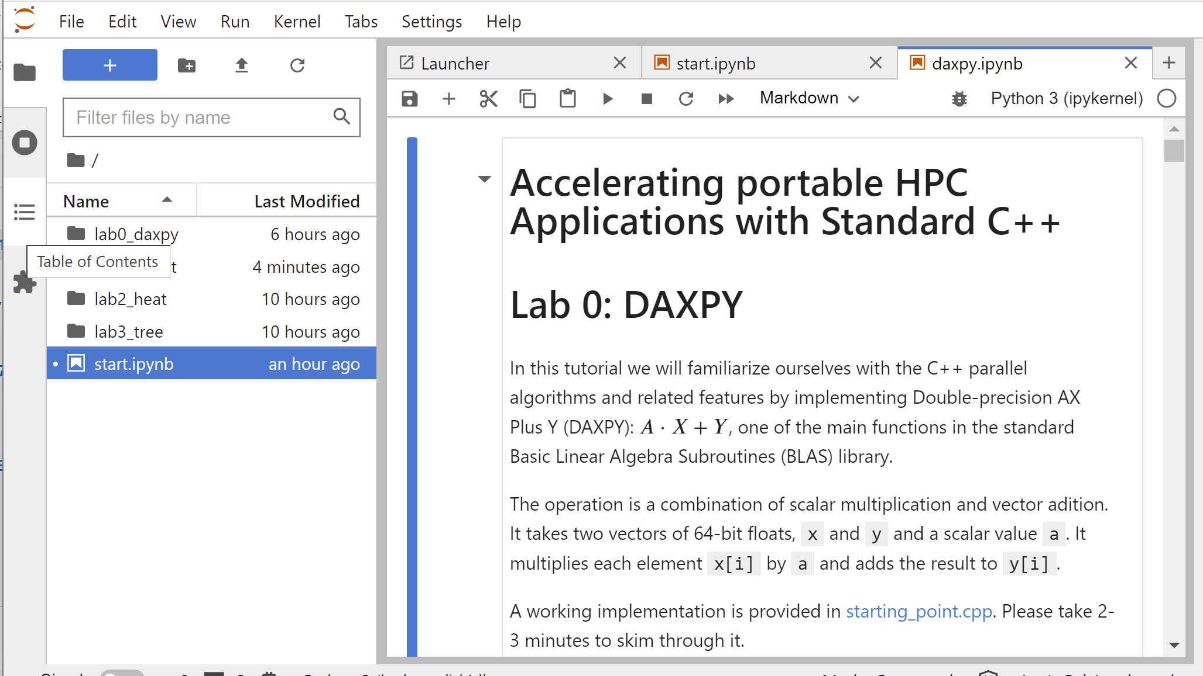
BLAS DAXPY 3 Exercises
Exercise 1: rewrite the for-loop implementation of the BLAS DAXPY kernel using sequential STL algorithms
Exercise 2: rewrite the for-loop implementation of the “initialization” kernel using sequential STL algorithms with any of the indexing approaches discussed in the tutorial
Exercise 3: parallelize the STL versions of the application using the Execution Policies

Slide 39
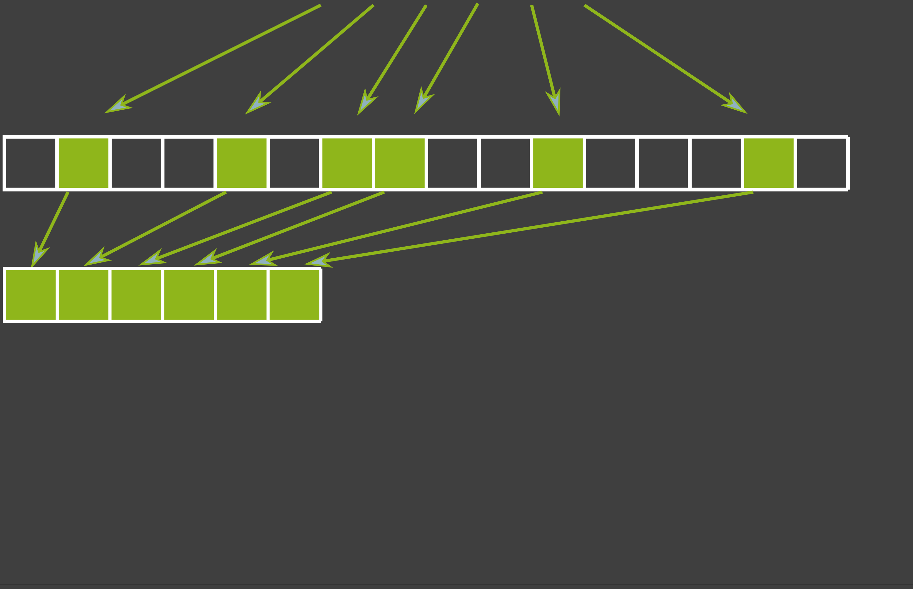
Extra Credit: Select
Exercise 1: write the function select, which copies selected values from v to w.
Elements selected by predicate pred
std::vector v
std::vector w
Sequentially no problem, but how to write a parallel algorithm ?
template<class UnaryPredicate>
std::vector<int> select( const std::vector<int>& v,
UnaryPredicate pred );

Slide 40
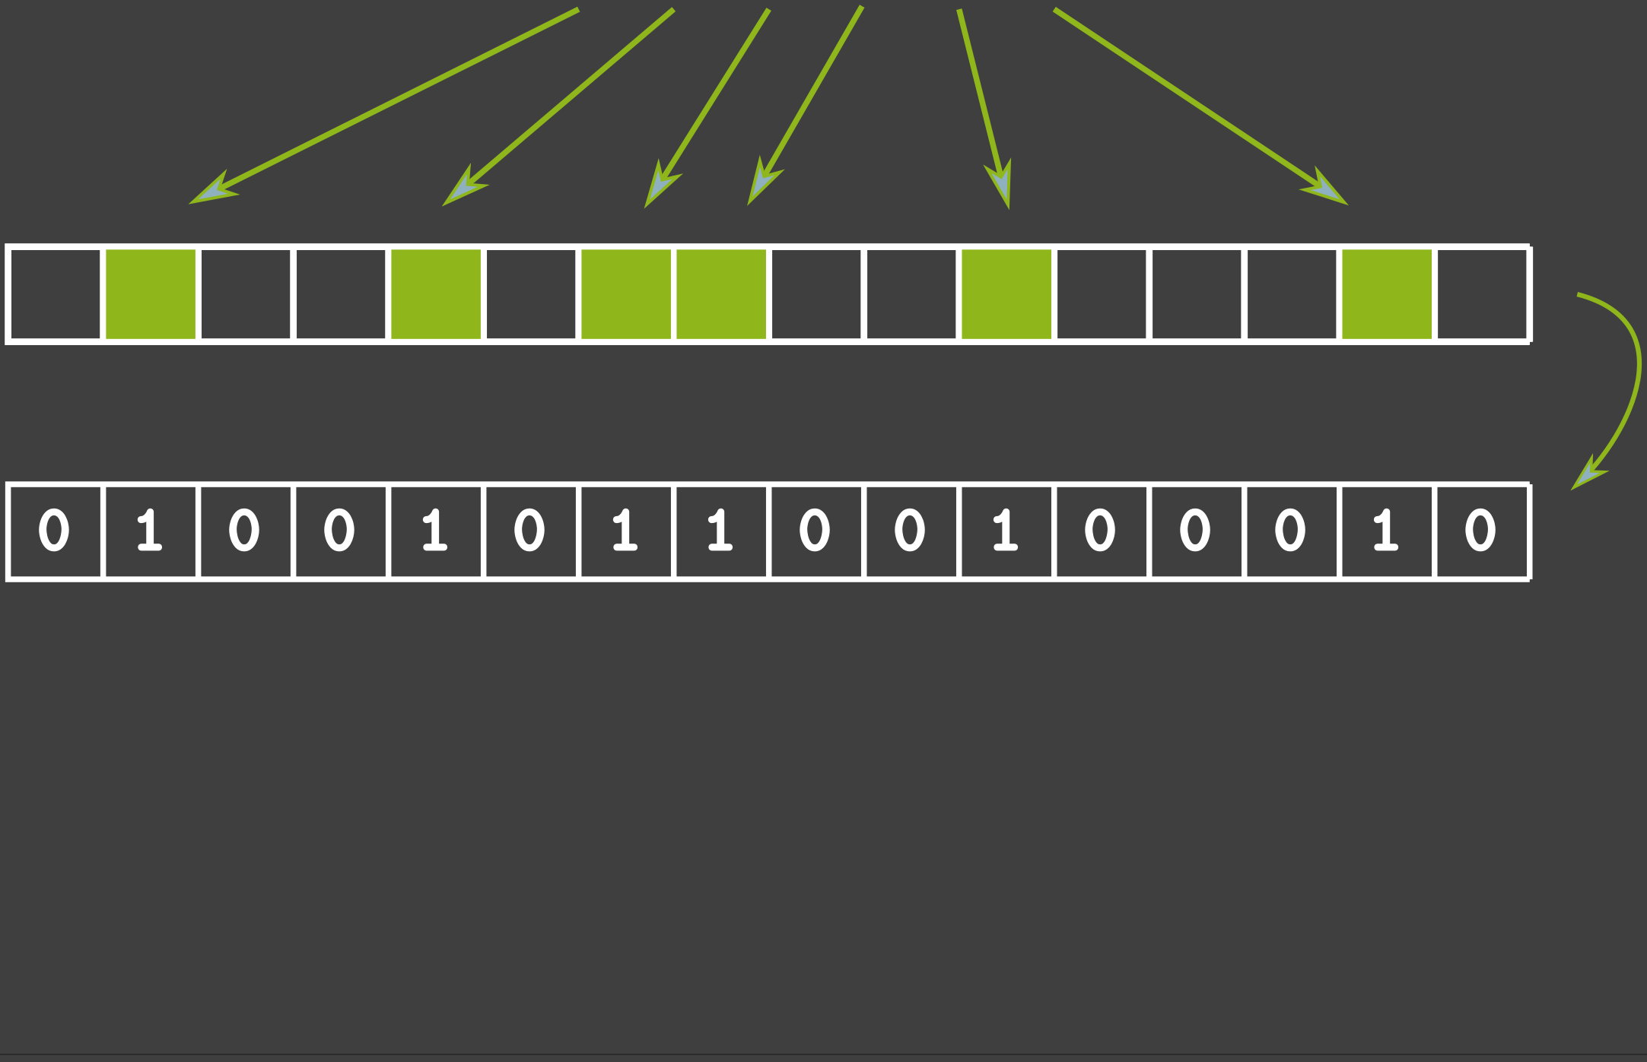
Extra Credit: Select
Step 1: Write out a binary-valued array for the values of the predicate.
Elements selected by predicate pred
std::vector v
std::transform
std::vector w

Slide 41
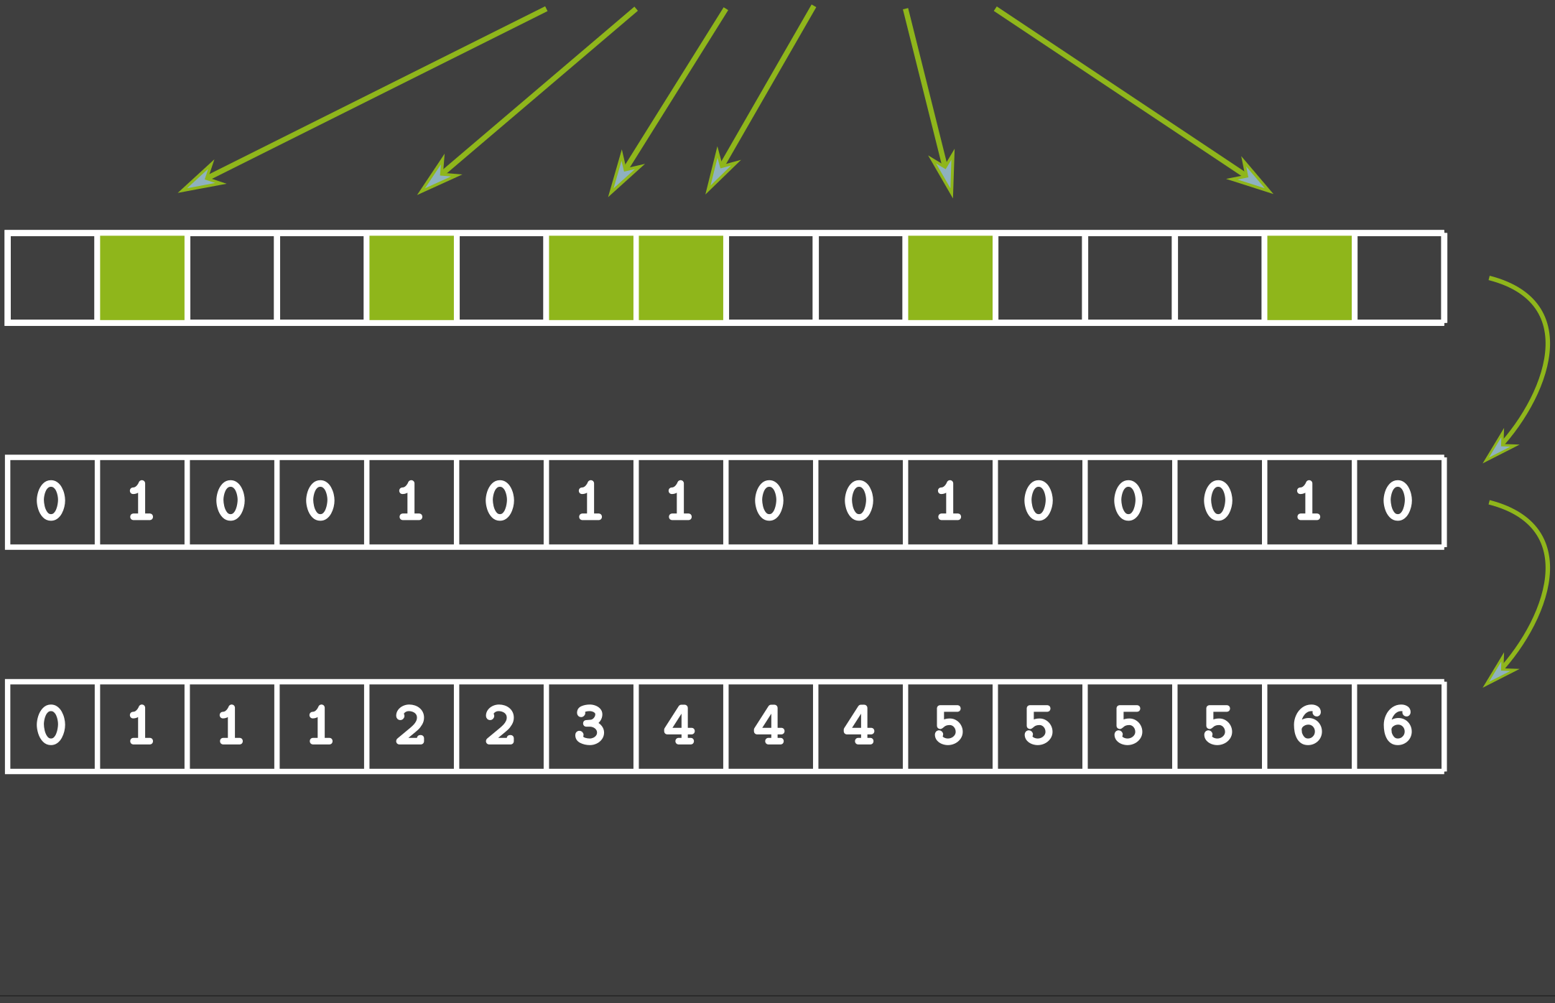
Extra Credit: Select
Step 1: Write out a binary-valued array for the values of the predicate.
Step 2: Compute the cumulative sum of this array.
Elements selected by predicate pred
std::vector v
std::transform
std::vector w
std::inclusive_scan
std::vector index

Slide 42
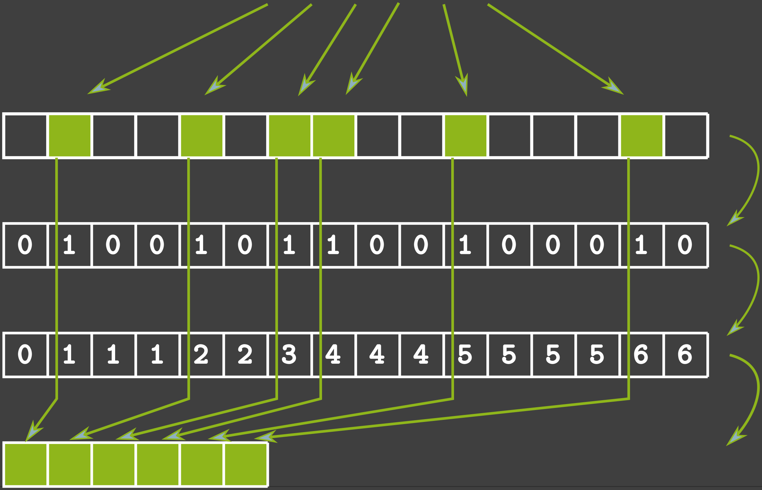
Extra Credit: Select
Step 1: Write out a binary-valued array for the values of the predicate.
Step 2: Compute the cumulative sum of this array.
Step 3: Process vector v in parallel and use the cumulative sum to write to proper indices.
Elements selected by predicate pred
std::vector v
std::transform
std::vector w
std::inclusive_scan
std::vector index
std::for_each
std::vector w

Slide 43
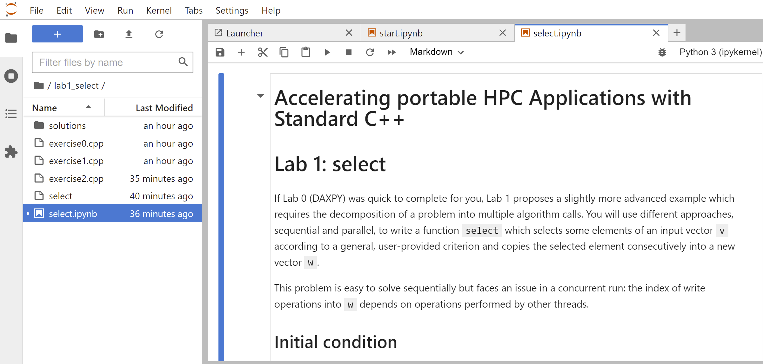
Extra Credit: Select 3 Exercises
Exercise 1: write a sequential version of the function select that uses the algorithm std::copy_if and a back inserter for vector w.
Exercise 2: write a parallel version of the function select that works with two temporary vectors v_sel and index.
Exercise 3: reduce the number of steps from 3 to 2 and avoid the creation of v_sel using the algorithm transform_inclusive_scan.

Slide 44
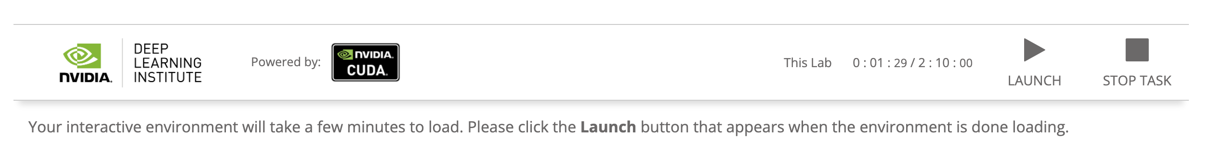
The Interactive Materials

Slide 45
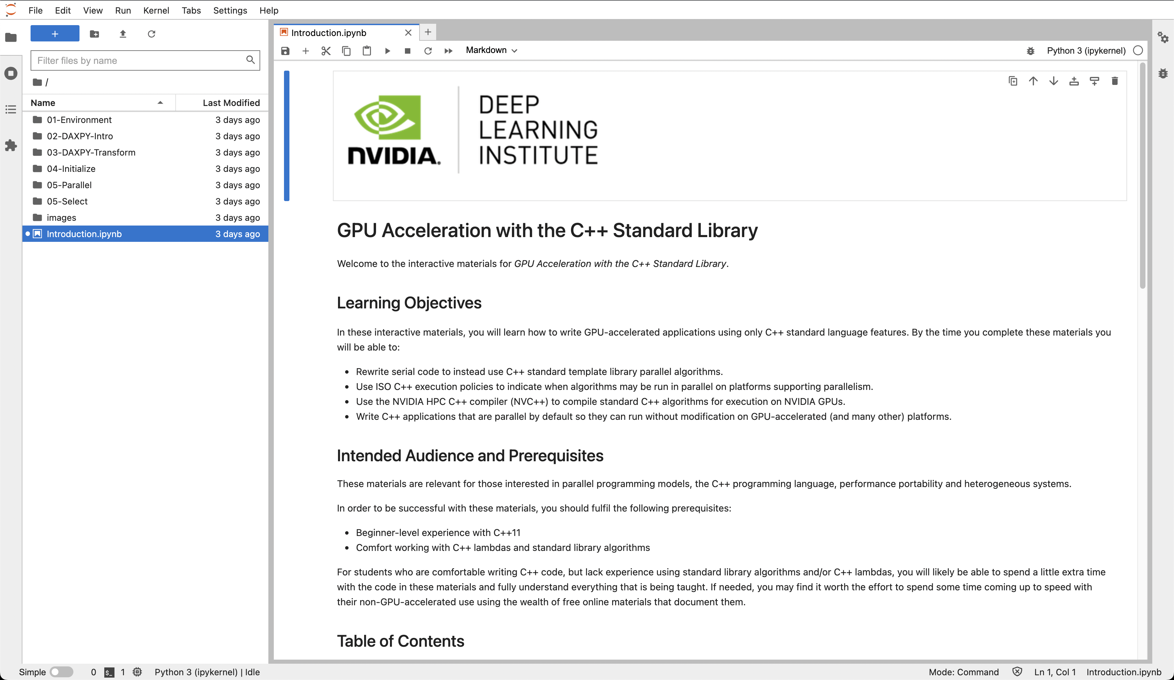
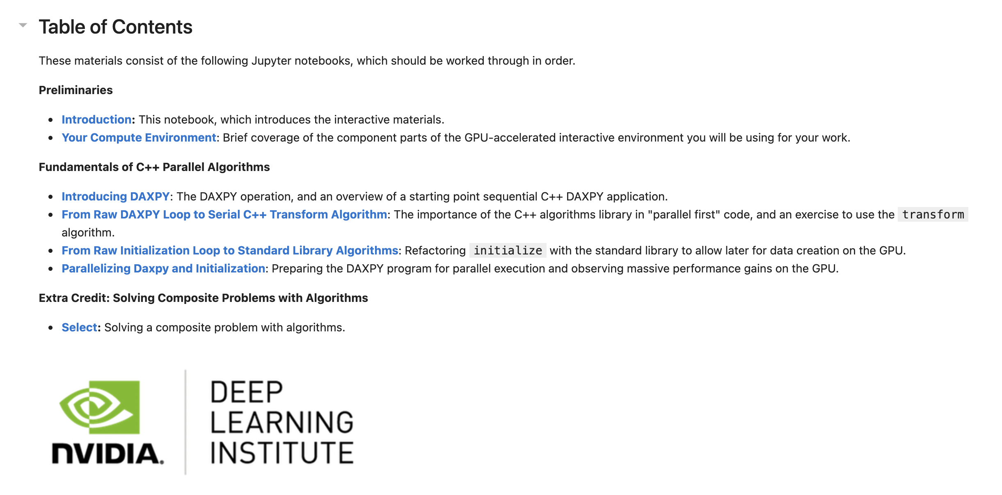
The Interactive Materials

Slide 46
GPU Acceleration with the C++ Standard Library

